Slide 1
Neural microcolumns as transmission lines: impulse response, effects of noise and firing rate encoding
Vincent Baker
Drexel University Department of Physics

Slide 2
Hypothesis
1-D neural microcolumn structures can exhibit traveling waves, synchronized firing activity that propagates along the microcolumn
Ensembles of weakly-connected microcolumns could be
An ensemble provides reliable transmission of population firing rates/firing times
A weakly-connected ensemble will respond strongly to synchronous input and respond weakly to uncorrelated noise
The all-or-nothing response of the traveling waves encodes sparse source information (i.e. average firing rate) into strong synchronized events
Disconnected microcolumns will not be reliable or synchronized, a fully-connected column will be susceptible to excessive noise triggering

Slide 3
Preliminary observations
Impulse stimulus creates traveling waves even in the presence of noise
Disconnected columns seem immune to noise-evoked traveling waves
Weakly-connected columns show some noise-evoked traveling waves, but seem to enhance stimulus-evoked traveling waves more than noise-evoked waves
Looked at firing rate encoding and transmission in a column ensemble
Disconnected columns DON’T seem to reliably transmit information about firing rate
Weakly-connected columns DO seem to reliably transmit information about firing rate, AND the information quality improves as the waves travel down the ensemble

Slide 4
Conceptual Neural Circuit
Simulation constructed from a pool of input neurons, a microcolumn (or microcolumn ensemble) as transmission line, and a pool of target neurons
Input neurons randomly connected to input layer of transmission line
Output layer of transmission line fully connected to output neurons
Transmission line
Input neurons
Output neurons

Slide 5
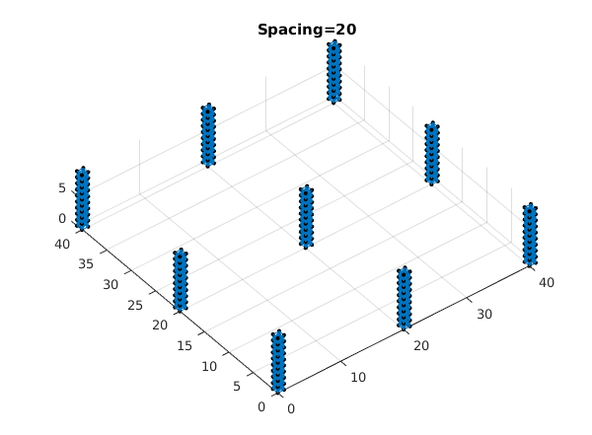
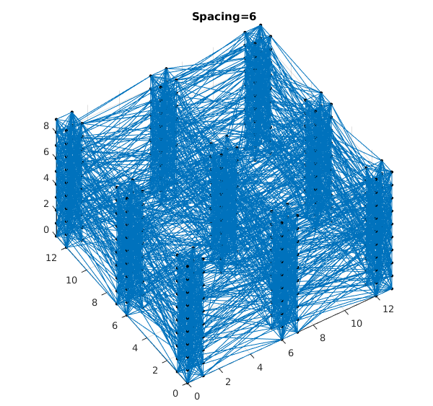
Methods – Our ensembles
Ensemble of 9 microcolumns, each microcolumn is 2x2x20
Disconnected (microcolumn spacing = 20) and weakly connected (spacing = 6)
Z
Y
X

Slide 6
Methods - Stimulus
Impulsive stimulus to all columns at input layer (Z=0) at t=0, 1s, 2s
All neurons receive background stimulus with strength M=3 (previous work used stronger background stimulus M=5)
“Input” here
“Output” here

Slide 7
Methods – Input/Output measurement
Plot firing rates of the input and output layer: both firing rate of each individual column and firing rate of entire ensemble
Firing rate = number of firing events over a 10 ms window
Plot impulse stimulus positions at top of graph for reference

Slide 8
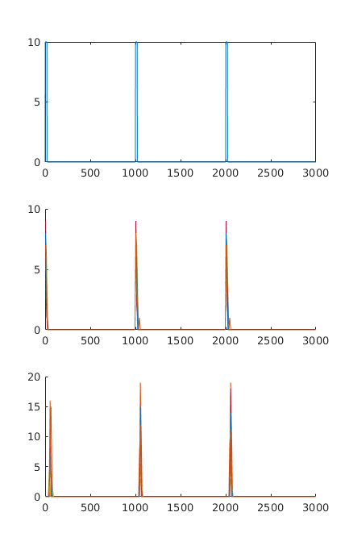
Results: Impulse stimulus+noise, disconnected columns
Top box shows impulse times
Disconnected columns seem to be relatively immune noise-triggered traveling waves.
Output firing rates are a little more correlated but qualitatively very similar to input.
INPUT layer firing rates, all 9 columns plotted using 9 colors
OUTPUT layer firing rates, all 9 columns plotted using 9 colors

Slide 9
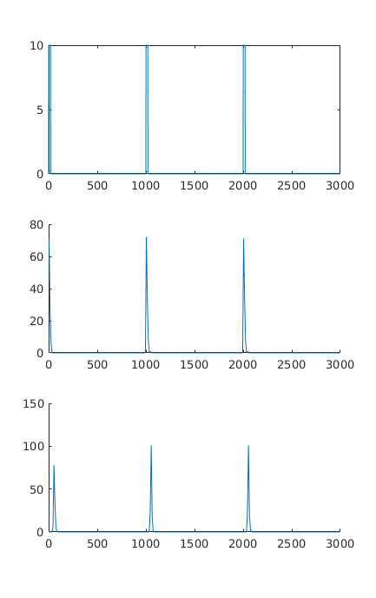
Results: Impulse stimulus+noise, disconnected columns
Top box shows impulse times
Firing rate of ENTIRE input/output layer (important for some other results, not very interesting here)
INPUT layer firing rates, all 9 columns plotted using 9 colors
OUTPUT layer firing rates, all 9 columns plotted using 9 colors

Slide 10
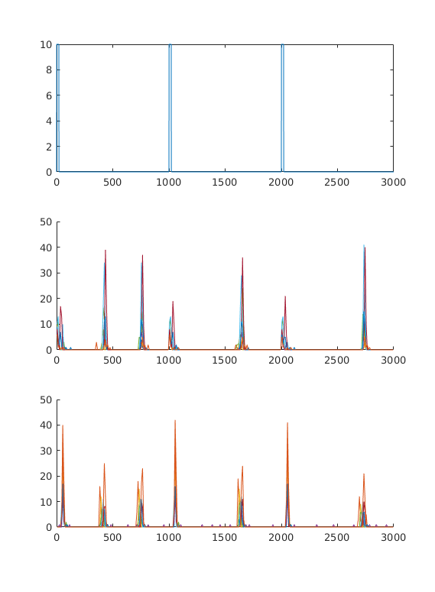
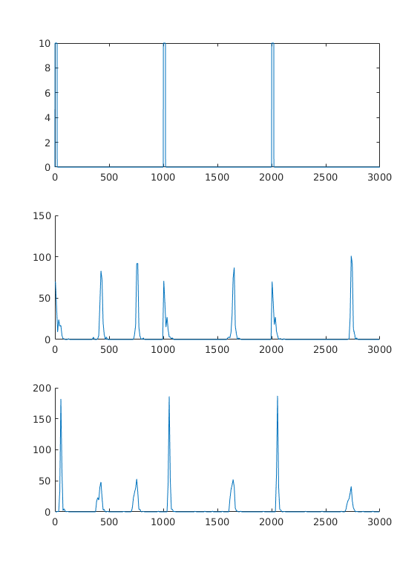
Results: Impulse stimulus+noise, weakly connected columns
Top box shows impulse times
INPUT layer firing rates, all 9 columns plotted using 9 colors
OUTPUT layer firing rates, all 9 columns plotted using 9 colors
Weakly-connected columns more susceptible to noise-triggered traveling waves.
Column seems to enhance stimulus-triggered waves more than noise-triggered waves.

Slide 11
Method: firing rate encoding
Use a column ensemble to encode the firing rate of a pool of input neurons
Input pool of 50 neurons, connected to excitatory neurons in the input layer of ensemble with probability 50%
Connection strength is a constant 5/2
No connections to inhibitory neurons in input layer
Each input neuron firing sequence is a Poisson spike train generated from the common instantaneous firing rate
Firing rate is a shifted sine wave, 0-8, frequency 3 Hz
All neurons still receive same background stimulus as impulse response test

Slide 12
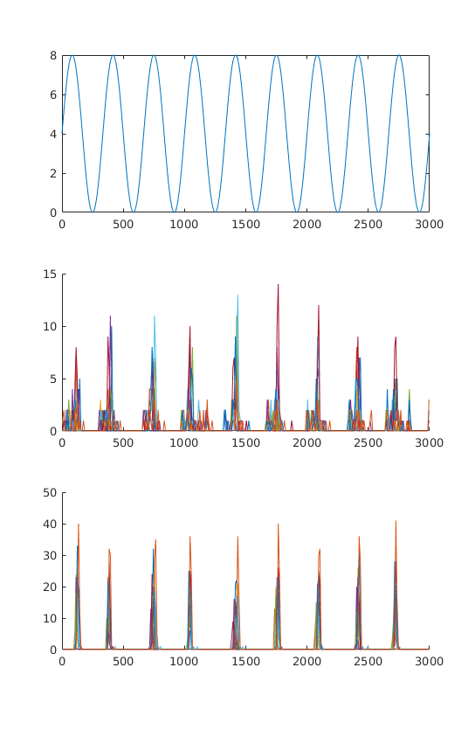
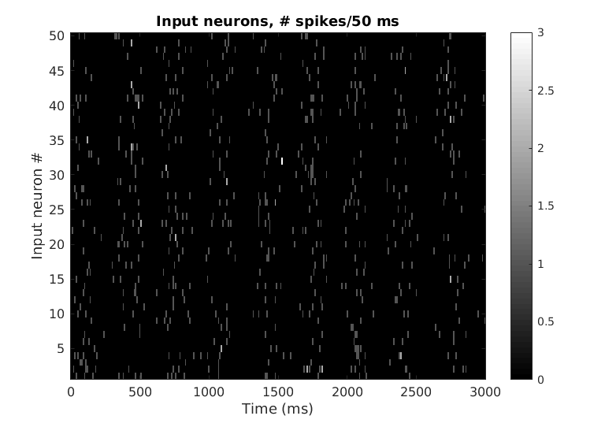
Firing rate example
Color plot of the firing rate of each neuron in the “input pool” over 10 ms window
Structure is apparent visually, but much more interesting than impulse stimulus

Slide 13
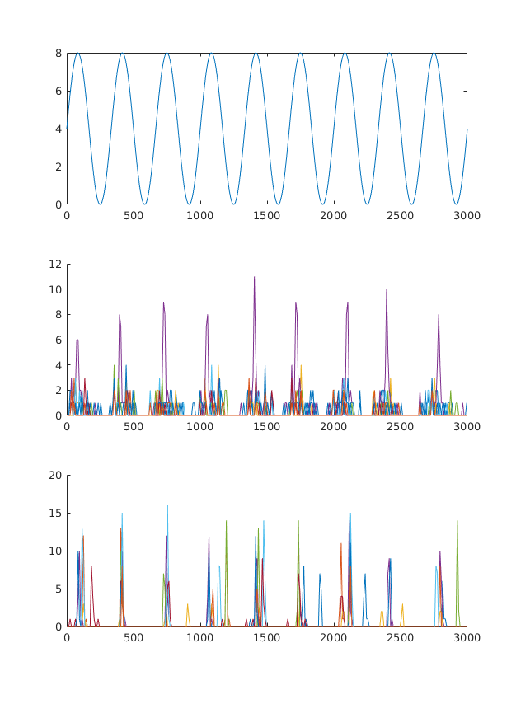
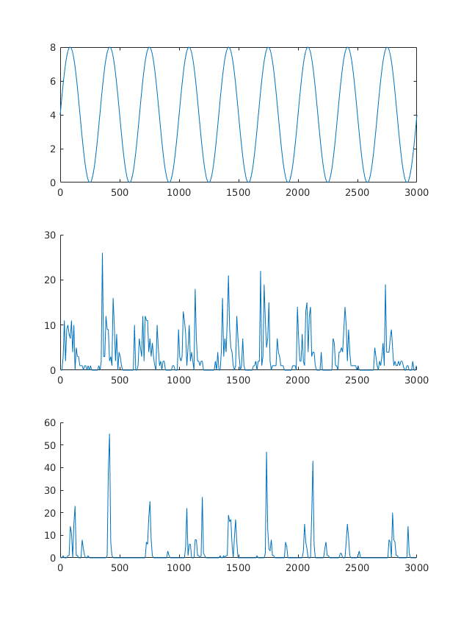
Results: Firing rate encoding + noise, disconnected columns
Top box shows input firing rate
INPUT layer firing rates, all 9 columns plotted using 9 colors
OUTPUT layer firing rates, all 9 columns plotted using 9 colors
Disconnected columns don’t reliably transmit information about input firing rate.

Slide 14
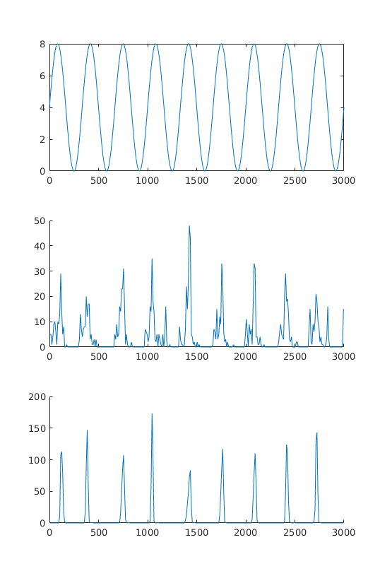
Results: Firing rate encoding + noise, weakly connected columns
Top box shows input firing rate
INPUT layer firing rates, all 9 columns plotted using 9 colors
OUTPUT layer firing rates, all 9 columns plotted using 9 colors
Weakly connected columns DO reliably transmit information about input firing rate.
Ensemble appears to filter the signal, reducing noise.

Slide 15
Next steps
Letter route:
Briefly state single column
Firing rate encoding
Non-Letter route
One big paper
2-D paper

